Slide 1
Capstone Project Hotel Booking Analysis EDA analysis Debashish Das Lucky Jain Vivek Katolkar

Slide 2
Content :-
● Importing and loading data of Hotel booking analysis
● Data summary
● Data cleaning
● Data preparation
● Questions which we asked our Data
● Challenges
● Conclusion
● Thank & You

Slide 3
Steps took to Analysis Hotel Booking Data
Step 1: Importing the necessary Libraries
Step 2: Mounting Google Drive and Creating a file path
Step 3: Importing Dataset From Drive
Step 4: Printing the information about a Data Frame including the index dtype and columns, non-null values and memory usage.
Step 5: We are going to use Pandas describe() view some basic statistical details like percentile, mean, std etc.
Step 6: Checking the sum of null values present in our dataset
Step 7 : Create New columns
Step 8: Taking Necessary Columns Only
Step 9: Answering Question

Slide 4
Data summary:-
Data set
Hotel booking analysis database includes information about the hotels booked between the year 2015 to year 2017
Shape: Rows & Columns
119390
32
Important columns-
is_canceled,lead time, arrival date, no. of persons, repeated guest, no. of kids

Slide 5
Data Cleaning :- Cleaning data is crucial step before EDA as it will remove the ambiguous data that can affect the outcome of EDA.
While cleaning data we will perform following steps:
1) Remove duplicate rows
2) Handling missing values.
3) Convert columns to appropriate datat ypes.
4) Adding important columns

Slide 6
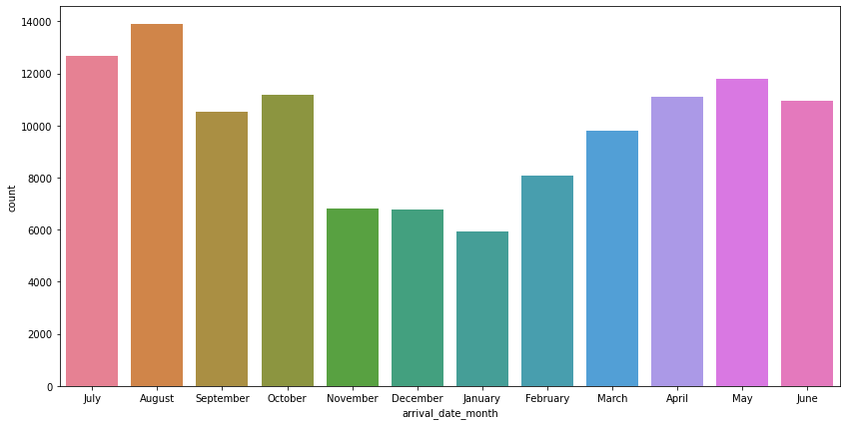
How many confirmed bookings are there in a month ?
August :13877
July :12661
May :11791
October :11160
April :11089
June :10939
September :10508
March :9794
February :8068
November :6794
December :6780
January :5929
Name: arrival_date_month, dtype: int64
August Month 13877 is high confirmed booking hotel.
July month having 2nd Highest 12661 booking confirmed
May month having 3rd highest 11791 booking conform.

Slide 7
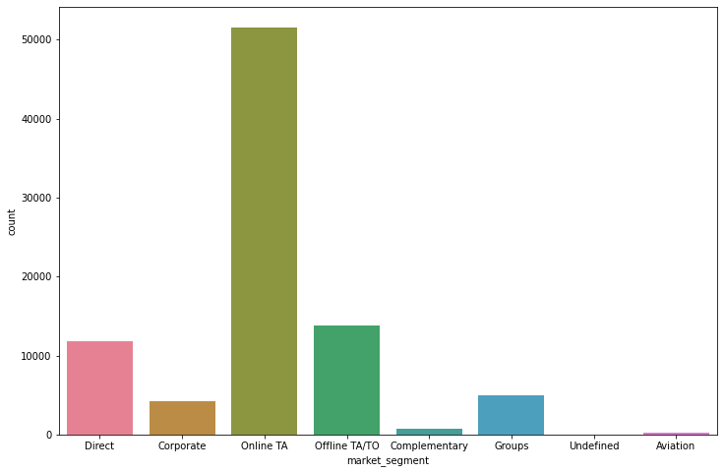
Which month get most visitors?
.
Online TA 0.591001
Offline TA/TO 0.158833
Direct 0.135045
Groups 0.056426
Corporate 0.048149
Complementary 0.007933
Aviation 0.002591
Undefined 0.000023
Around 59% of bookings are made via Online Travel Agents,
Almost 16% of bookings are made via Offline Travel
Agents and less than 15% are Direct bookings without any other agents

Slide 8
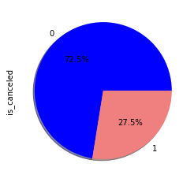
How many cancelled are there after booking?
Total Bookings cancelled 0 63221 1 24009
Name: is cancelled, dtype: int64
Cancelation percentage 0 0.724762 1 0.275238 Name: is cancelled, dtype: float64
According to the pie chart, 72.5% of bookings were not cancelled and 27.5% of the bookings were canceled at the Hotel.

Slide 9
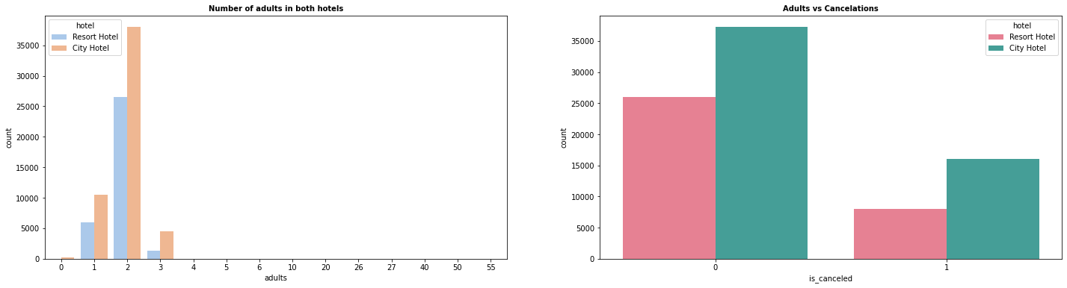
Which type of hotels are preferred by adults ?
Adult most prefer city hotel, adult cancelled are less.

Slide 10
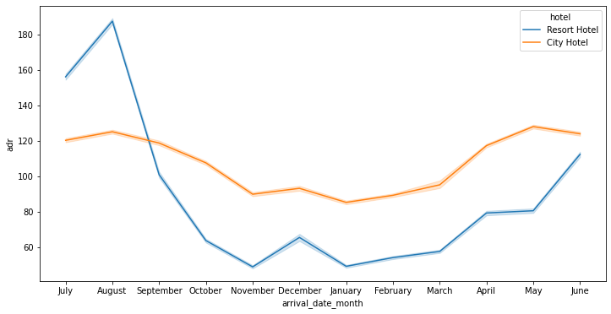
Which month are most expensive hotels ?
For resort hotels, the average daily rate is more expensive during august, July and September.
For city hotels, the average daily rate is more expensive during august, july, june and may.

Slide 11
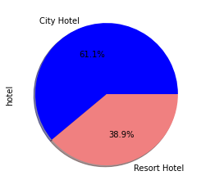
Which type of hotel most booking percentage?
61.1% of people prefers booking .
38.9% of people prefers resort hotel booking

Slide 12
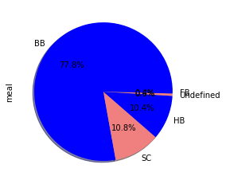
Which type of most prefer meal ?
77.8% people prefer (BB — Bed & Breakfast) meal
10.8% people prefer( SC /undefine )meal
10.4% people prefer Half board (breakfast and one other meal — usually dinner)

Slide 13
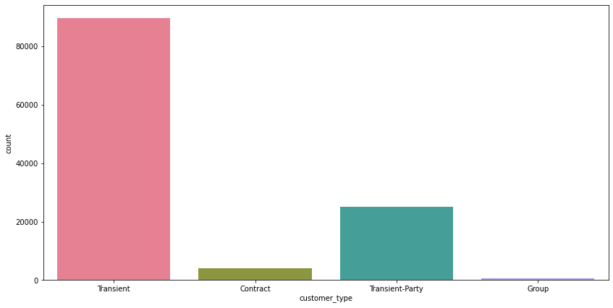
Which customer type are having most booking ?
Transient 0.823822
Transient-Party 0.134036
Contract 0.035939 Group 0.006202 Name: customer_type, dtype: float64
82% of Transient are having customer type most booking.
13% Transient –party are having customer type most booking

Slide 14
Questions which we are going to ask our Data
How many confirmed bookings are there in a month ?
How many confirmed bookings are there in a month ?
Which month get most visitors?
Which type of hotels are preferred by adults.
Which month are most expensive hotels?
Which type of hotel most booking percentage?
Which type of most prefer meal?
Which customer type are having most booking ?
Which hotel type most booking in weekend night and cancelled?
How many family member per reservation ?
How many customer have booked and then cancelled?
Which months are having most expensive hotels?

Slide 15
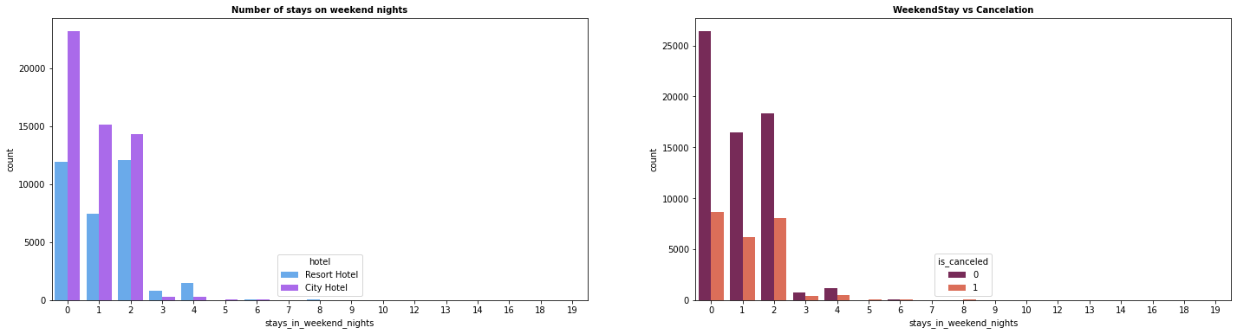
Which hotel type most booking in weekend night and cancelled?
In the first graph we can see that most of the weekend nights were booked in City Hotel
Second plot shows most of weekend nights which were booked were not canceled

Slide 16
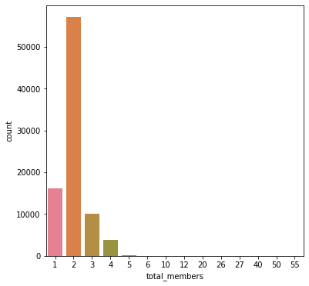
How many family member per reservation ?
65% of 2 people in family are having most reservation.
18% of 1 people are having most reservation.
11% of 3people in family are having most reservation

Slide 17
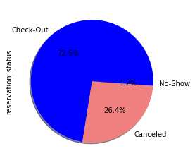
How many customer have booked and then cancelled?
Check-Out 0.724762
Canceled 0.263625
No-Show 0.011613
Name: reservation_status,
dtype: float64
26 % of after booking canceled
72% of customers are check-out

Slide 18

Which months are having most expensive hotels?
For resort hotels, the average daily rate is more expensive during august, July and September.
For city hotels, the average daily rate is more expensive during august, July, June and may.

Slide 19
CHALLENGES :-
The name of the countries was not in the proper format ,because of which we are not able to plot the geomean plot.
column has lots of duplicate value a.
Company, agent and country column has lots of null value values as.
There were many rows with almost similar data
create some new column

Slide 20
Conclusion :-
Majority of the guests are from Western Europe. We should spend a significant amount of our budget on those area .Encourage Direct bookings by offering special discounts
Majority of the hotels are booked by city hotels. Definitely need to spend the most targeting fund on those hotel.
The number of repeated guests are too low. we should target our advertisement on guests to increase returning guests.
The majority of reservations converts into successful transactions.
We have also realize that the high rate of cancellations can be due to high no deposit policies.
We should also target months between May to Aug. Those are peak months due to the summer period.
Strategies to Counter High Cancellations at the Hotel
Set Non-refundable Rates, Collect deposits, and implement more rigid cancellation policies.
Monitor where the cancellations are coming from such as Market Segment, distribution channels, etc.

Slide 21
Thank You

